Slide 1
Acess Control

Slide 2
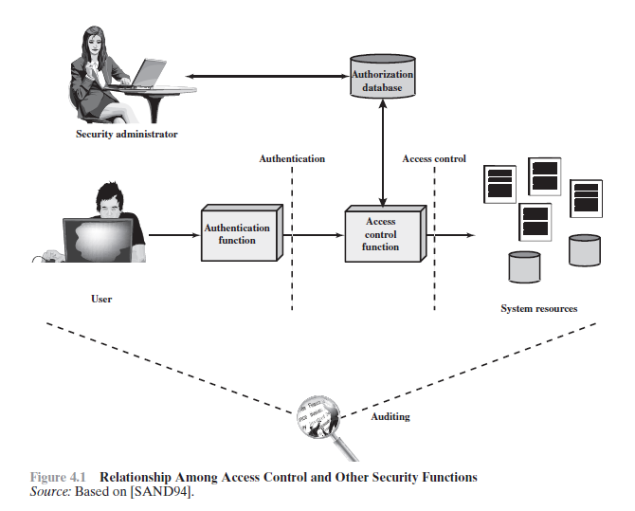
Access Control Principles

Slide 3
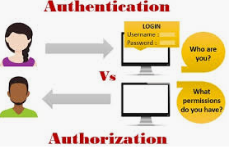
Introduction
Access control is the collection of mechanisms that permits managers of a system to exercise a directing or restraining influence over the behavior, use, and content of a system.
It permits management to specify what users can do, which resources they can access, and what operations they can perform on a system.
The goal of access control is to minimize the security risks of unauthorized access to physical and logical systems
It consists of main components: authentication and authorization, audit

Slide 4
Access control types
Physical access control: limits access to campuses, building, rooms, and physical IT assets. (Fencing, hardware door locks,… that limit contact with devices)
Technical access control: technology restrictions that limit users on computers from accessing data
Access controls encompass:
File permissions, such as the right to create, read, edit or delete a file.
Program permissions, such as the right to execute a program.
Data permissions, such as the right to retrieve or update information in a database.

Slide 5
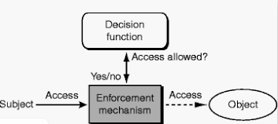
Components
The security features that control how users and systems communicate and interact with one another.
Access: The flow of information between subject and object
Subject: An active entity that requests access to an object or the data in an object
Object: A passive entity that contains information

Slide 6
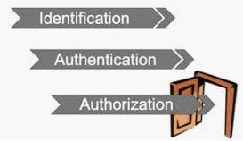
Access Control Terminology
Identification, authorization, and authorization are distinct functions.
Identification
Method of establishing the subject’s (user, program, process) identity.
Authentication
Method of proving the identity
Authorization
Determines that the proven identity has some set of characteristics associated with it that gives it the right to access the requested resources.

Slide 7
Identification
Identification asks the question: "Who are you?" When a new user completes the registration process, they are identifying themselves for you. Some companies limit their identity management process to just identification, taking the information users provide at face value. This can be very risky.
Identification is the process of presenting an identity to a system. It is done in the initial stages of gaining access to the system and is what happens when you claim to be a particular system user.
Verification moves from "Who are you?" to "Prove it." To verify the person is using their real name, address, phone number and so on, enterprises ask for verification. Verification can be in the form of a driver's license or government issued ID card, or biometric data, such as fingerprints or verified photos to be used for facial recognition.

Slide 8
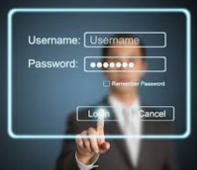
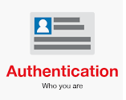
Authentication
Authentication is the ability to prove that a user or application is genuinely who that person or what that application claims to be.
For example, consider a user who logs on to a system by entering a user ID and password. The system uses the user ID to identify the user. The system authenticates the user at the time of logon by checking that the supplied password is correct.

Slide 9

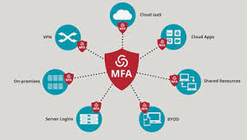
Authentication
Strong authentication is important
To be properly authenticated, the subject is usually required to provide a second piece to the credential set (i.e., password, passphrase, key, PIN, token etc.

Slide 10
Authentication factors
Authentication factors determine the many different elements the system uses to verify one’s identity before granting the individual access to anything.
something you know
Something you have
Something you are

Slide 11

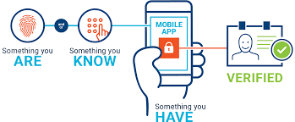
Authentication factors
Based on the security level, authentication factors can vary from one of the following:
Single- Factor Authentication
Two- Factor Authentication (2FA)
Multi- Factor Authentication (MFA)

Slide 12
Something you know (Knowledge-based)
Passwords are the most common form of authentication
PIN
Simple Password Authentication
User Name, Password
/etc/shadow

Slide 13
Something you know
User-entered Password
Password hash stored on file e.g. /etc/shadow
H1
Password Verification
Hash Function
H2
Y
H1==H2?
OK
N
FAIL

Slide 14
Something you know
“Passwords are one of the biggest practical problems facing security engineers today.”
Problems:
Easy to share (intentionally or not)
Easy to forget
Often easy to guess
Too many passwords to remember
Complex password policy
Forcing users to pick stronger passwords
Password vulnerabilities
Access the password file
Brute force attacks
Directory attacks
Social engineering

Slide 15
The Vulnerability of Passwords
Offline dictionary attack
Specific account attack
Popular password attack
Password guessing against single user

Slide 16
Password Cracking of User-Chosen Passwords
Tradition Approach
Brute force.
Dictionary.
Rainbow table.
Modern Approach.
Increase power of computing (GPU)
Sophisticated algorithms

Slide 17
Strategies for strong passwords
Proactive password checking
Users select a potential password which is tested
Weak passwords are not accepted
Reactive password checking
SysAdmin periodically runs password cracking tools to detect weak passwords that must be replaced
Computer-generated passwords
Random passwords are strong but difficult to remember

Slide 18

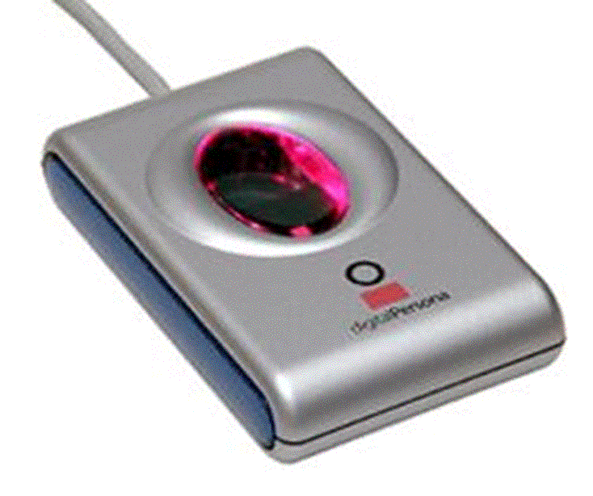
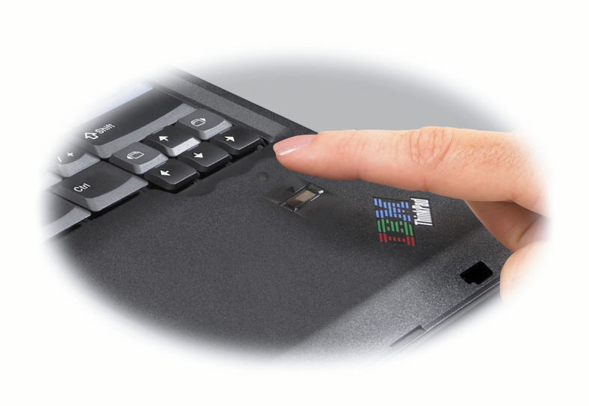
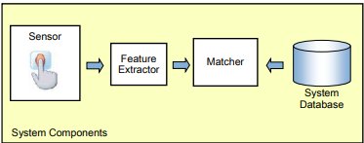
Something you are/do (Inherence-based)
Biometric - “You are your key”
Examples:
Fingerprint
Handwritten signature
Facial recognition
Speech recognition
Iris
Voice
…

Slide 19
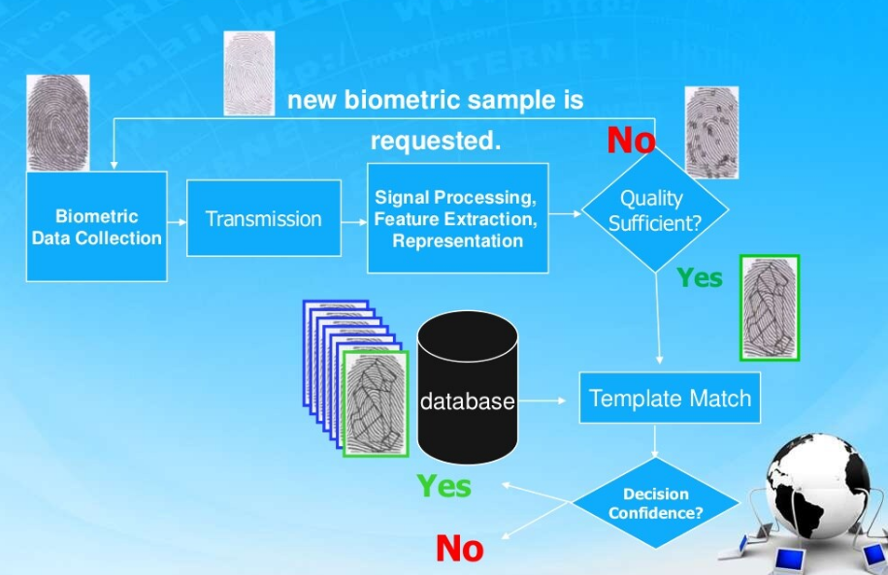

Slide 20
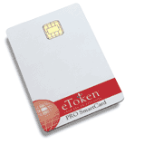

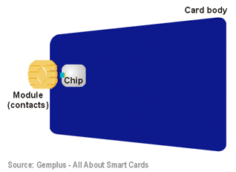
Something you have (Ownership-based)
E-Token: store credentials such as passwords, digital signatures and certificates, and private keys
RFID: Integrated circuit(s) with an antenna that can respond to an RF signal with identity information
Smart card
Digital Certificates (used by Websites to authenticate themselves to customers)

Slide 21
One Time Password
Dynamic password that change frequently
Systems using OTPs generate a unique password on demand that is not reusable

Slide 22
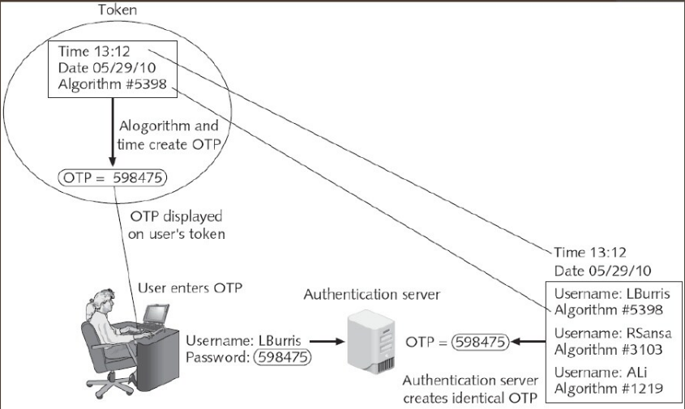
Time-synchronized OTP

Slide 23
Challenge-based OTP
Authentication server displays a challenge (a random number) to the user
User then enters the challenge number into the token (executes a special algorithm to generate a password)
Because the authentication server has the same algorithm, it can also generate the password and compare it against that entered by the user.

Slide 24
Single Sign On
Multiple applications, each requires login
Provide users with the ability to login only once for usability
Automatically propagate login to all applications

Slide 25
Single Sign On
Advantages
Unified mechanism
One login/password to remember
New applications reuse code
Disadvantages
Can weaken security
Example: OIDC, SAML

Slide 26
Implementing authentication
Local authentication
Network authentication

Slide 27
Authentication Server
Radius
Kerberos
TACACS+
LDAP

Slide 28
RADIUS
Wired and Wireless LANs
Radius clients: server, switch, AP
Radius server authenticates and authorized the radius client requests

Slide 29
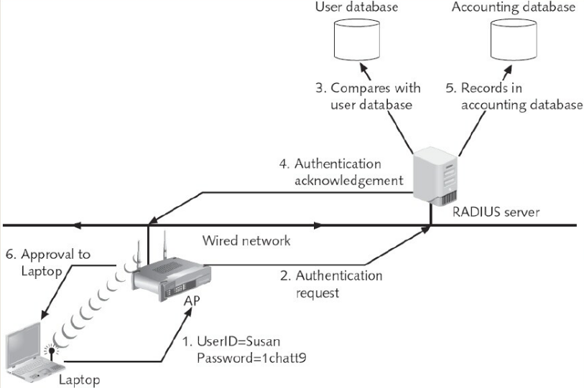

Slide 30
Authorization
Determines that the proven identity has some set of characteristics associated with it that gives it the right to access the requested resources.
Grating access rights to subjects should be based on the level of trust a company has in a subject and the subject’s need to know.
Is a core component and established whether a user is authorized to access a particular resource and what actions he is permitted to perform on the resource.

Slide 31
Subjects, Objects, and Access Rights
A subject is an entity capable of accessing objects
Owner: This may be the creator of a resource, such as a file. For system resources, ownership may belong to a system administrator. For project resources, a project administrator or leader may be assigned ownership.
Group: In addition to the privileges assigned to an owner, a named group of users may also be granted access rights, such that membership in the group is sufficient to exercise these access rights. In most schemes, a user may belong to multiple groups.
World: The least amount of access is granted to users who are able to access the system but are not included in the categories owner and group for this resource.

Slide 32
Subjects, Objects, and Access Rights
An object is a resource to which access is controlled.
access right describes the way in which a subject may access an object. Access rights could include the following:
Read
Write
Execute
Delete
Create
Search

Slide 33
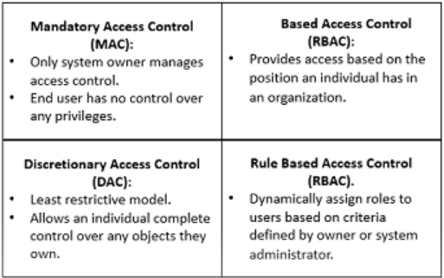
Access Control models
How does someone grant the right level of permission to an individual so that they can perform their duties? Access control models define how permissions are assigned.
Access control model – hardware and software predefined framework that custodian can use for controlling access
Access control models have four flavors:
Mandatory access control (MAC)
Discretionary access control (DAC)
Role-Based access control
Rule-Based access control
Attribute-based access control

Slide 34
Mandatory Access Control (MAC)
This is a security model in which access rights are regulated by a central authority based on multiple levels of security.
This means the end user has no control over any settings that provide any privileges to anyone.

Slide 35
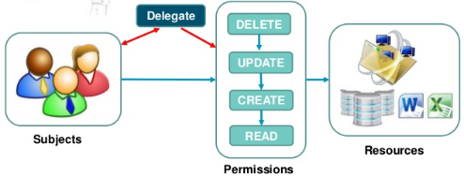
Discretionary Access Control (DAC)
DAC allows an individual complete control over any objects they own along with the programs associated with those objects.

Slide 36
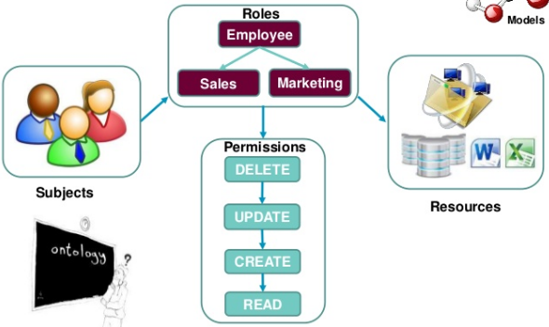
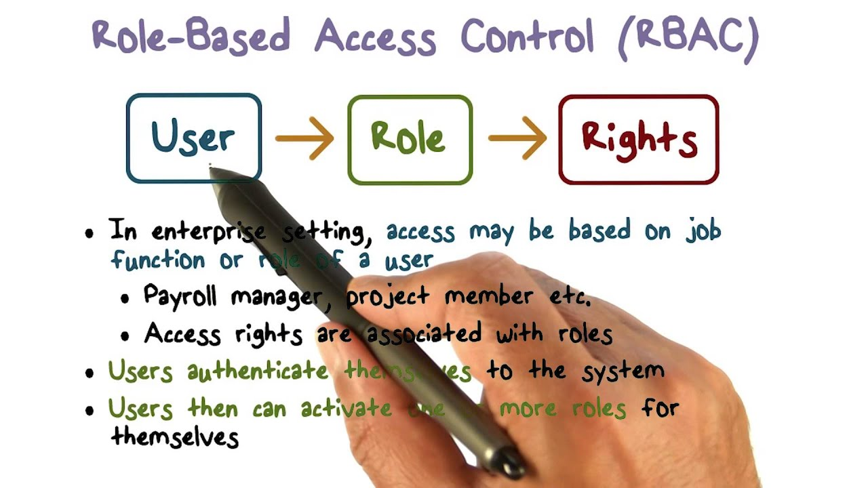
Role-Based Access Control (RBAC)
Provides access control based on the position an individual fills in an organization.
Restricts access to computer resources based on individuals or groups with defined business functions.

Slide 37
Rule-Based Access Control
This is a security model in which the system administrator defines the rules that govern access to resource objects.
These rules are based on conditions, such as time of day or location.
For example: if someone is only allowed access to files during certain hours of the day, Rule-Based Access Control would be the tool of choice.

Slide 38
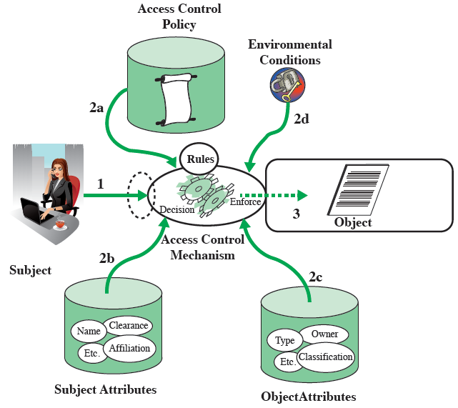
Attribute-based Access Control (ABAC)
Define authorizations that express conditions on properties of both the resource and the subject
Types of attributes
Subject attributes: Name, Organization, Job title
Object attributes: Title, Author, Date
Environment attributes: Describe the operational, technical, and even situational environment or context in which the information access occurs: Current date, Network security level, Current virus/hacker activities

Slide 39
Implementing Access Control
Access control is a process that is integrated into an organization’s IT environment. It can involve identity management and access management systems.
These systems provide access control software, a user database, and management tools for access control policies, auditing and enforcement.
When a user is added to an access management system, system administrators use an automated provisioning system to set up permissions based on access control frameworks, job responsibilities and workflows.
Access control requirement: least privilege

Slide 40
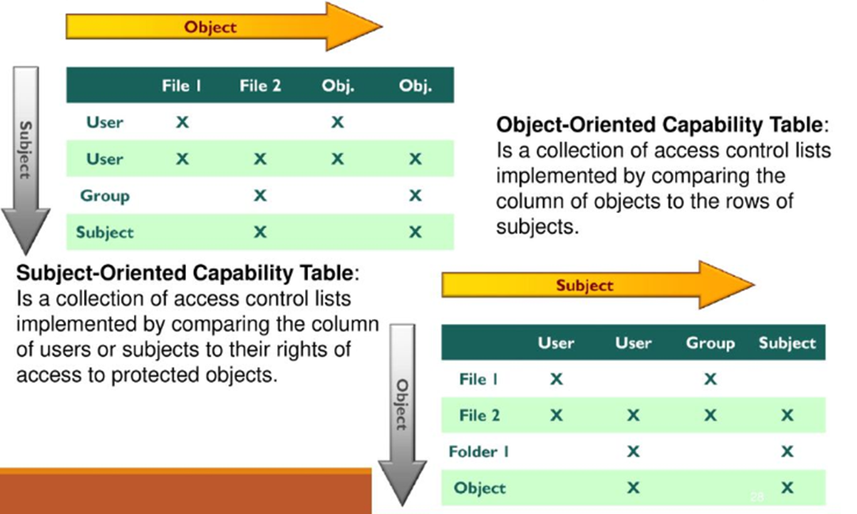
Access Control Matrix
Is a table of subjects and objects indicating what actions individual subjects can take upon individual objects
Two types:
Capability table (bound to a subject)
Access control List (bound to an object)

Slide 41
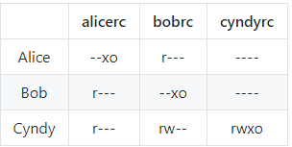
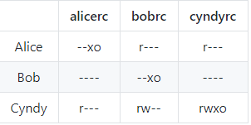
Ex1: Consider a computer system with three users: Alice, Bob, and Cyndy. Alice owns the file alicerc, and Bob and Cyndy can read it. Cyndy can read and write the file bobrc, which Bob owns, but Alice can only read it. Only Cyndy can read and write the file cyndyrc, which she owns. Assume that the owner of each of these files can execute it.
a. Create the corresponding access control matrix.
b. Cyndy gives Alice permission to read cyndyrc, and Alice removes Bob’s ability to read alicerc. Show the new access control matrix.

Slide 42
Ex2: Alice can read and write to the file x, can read the file y, and can execute the file z. Bob can read x, can read and write to y, and cannot access z
Write a set of access control lists for this situation. Which list is associated with which file?
Write a set of capability lists for this situation. With what is each list associated?
Set of access control lists. They are object focused so each list is associated with a file.
ACL(FileX) = Alice: {read, write}, Bob: {read}
ACL(FileY) = Alice: {read}, Bob: {read, write}
ACL(FileZ) = Alice: {execute}, Bob: {}
Set of capability lists. They are subject focused, so each list is associated with a user.
CList(Alice) = FileX: {read, write}, FileY: {read}, FileZ: {execute}
CList(Bob) = FileX: {read}, FileY: {read, write}, FileZ: {}

Slide 43
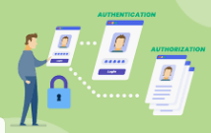

Authorization
Problems in controlling access to assess:
Different levels of users with different levels of access
Resources may be classified differently
Diverse identity of data
Corporate environments keep changing
Solutions that enterprise wide and single sign on solutions
User provisioning
Password synchronization and reset
Centralized auditing and reporting
Integrated workflow (increase in productivity)
Regulatory compliance

Slide 44
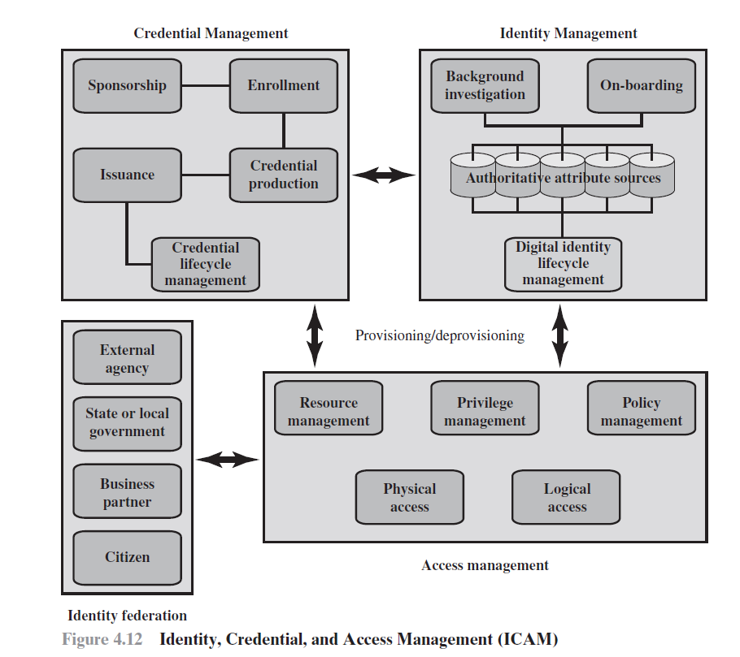
Identity, Credential, and Access Management

Slide 45
IdentityManagement
Identity management is concerned with assigning attributes to a digital identity and connecting that digital identity to an individual or NPE.
A final element of identity management is lifecycle management, which includes the following:
Mechanisms, policies, and procedures for protecting personal identity information
Controlling access to identity data
Techniques for sharing authoritative identity data with applications that need it
Revocation of an enterprise identity

Slide 46
Credential Manager
a credential is an object or data structure that authoritatively binds an identity (and optionally, additional attributes) to a token possessed and controlled by a subscriber
Credential management is the management of the life cycle of the credential.
An authorized individual sponsors an individual or entity for a credential to establish the need for the credential. For example, a department supervisor sponsors a department employee.
The sponsored individual enrolls for the credential, a process which typically consists of identity proofing and the capture of biographic and biometric data. This step may also involve incorporating authoritative attribute data, maintained by the identity management component.
A credential is produced. Depending on the credential type, production may involve encryption, the use of a digital signature, the production of a smartcard, or other functions.
The credential is issued to the individual or NPE.
Finally, a credential must be maintained over its life cycle, which might include revocation, reissuance/replacement, reenrollment, expiration, personal identification number (PIN) reset, suspension, or reinstatement.

Slide 47
Access Manager
The access management component deals with the management and control of the ways entities are granted access to resources.
Resource management: This element is concerned with defining rules for a resource that requires access control.
Privilege management: This element is concerned with establishing and maintaining the entitlement or privilege attributes that comprise an individual’s access profile.
Policy management: This element governs what is allowable and unallowable in an access transaction.

Slide 48
Identity Federation
Identity federation addresses two questions:
How do you trust identities of individuals from external organizations who need access to your systems?
How do you vouch for identities of individuals in your organization when they need to collaborate with external organizations?

